Slide 1

CHAPTER 5
SEQUENCES,
MATHEMATICAL
INDUCTION, AND
RECURSION
Copyright © Cengage Learning. All rights reserved.

Slide 2
SECTION 5.7
Solving Recurrence Relations by Iteration
Copyright © Cengage Learning. All rights reserved.

Slide 3
Solving Recurrence Relations by Iteration
Suppose you have a sequence that satisfies a certain recurrence relation and initial conditions.
It is often helpful to know an explicit formula for the sequence, especially if you need to compute terms with very large subscripts or if you need to examine general properties of the sequence.
Such an explicit formula is called a solution to the recurrence relation. In this section, we discuss methods for solving recurrence relations.

Slide 4
The Method of Iteration

Slide 5
The Method of Iteration
The most basic method for finding an explicit formula for a recursively defined sequence is iteration.
Iteration works as follows: Given a sequence a₀, a₁, a₂, . . . defined by a recurrence relation and initial conditions, you start from the initial conditions and calculate successive terms of the sequence until you see a pattern developing.
At that point you guess an explicit formula.

Slide 6





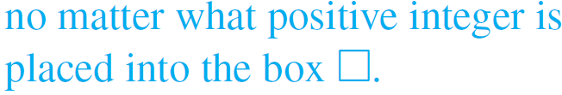
Example 1 – Finding an Explicit Formula
Let a₀, a₁, a₂, . . . be the sequence defined recursively as follows: For all integers k ≥ 1,
Use iteration to guess an explicit formula for the sequence.
Solution:
We know that to say
means

Slide 7
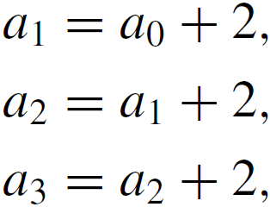
Example 1 – Solution
cont’d
In particular,
and so forth.
Now use the initial condition to begin a process of successive substitutions into these equations, not just of numbers but of numerical expressions.

Slide 8
Example 1 – Solution
cont’d
The reason for using numerical expressions rather than numbers is that in these problems you are seeking a numerical pattern that underlies a general formula.
The secret of success is to leave most of the arithmetic undone.
However, you do need to eliminate parentheses as you go from one step to the next. Otherwise, you will soon end up with a bewilderingly large nest of parentheses.

Slide 9
Example 1 – Solution
cont’d
Also, it is nearly always helpful to use shorthand notations for regrouping additions, subtractions, and multiplications of numbers that repeat.
Thus, for instance, you would write
and
Notice that you don’t lose any information about the number patterns when you use these shorthand notations.

Slide 10


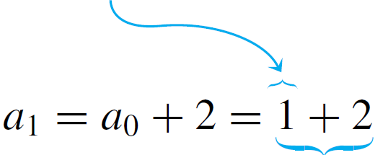

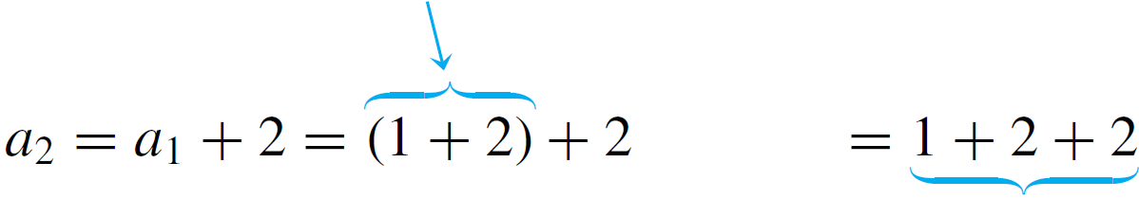

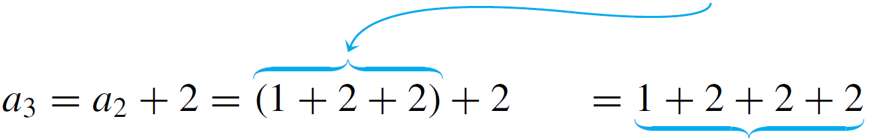
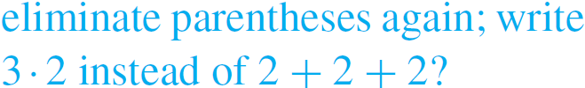
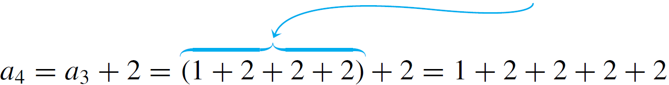
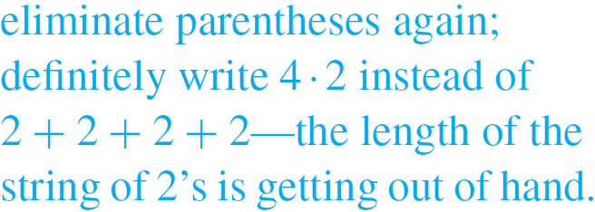
Example 1 – Solution
cont’d
Here’s how the process works for the given sequence:

Slide 11

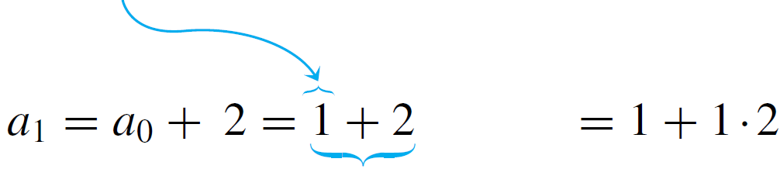

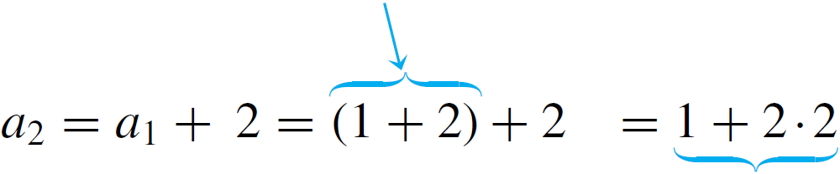
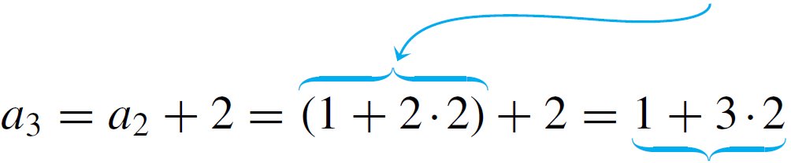
Example 1 – Solution
cont’d
Since it appears helpful to use the shorthand k  2 in place of 2 + 2 + · · · + 2 (k times), we do so, starting again from a₀.

Slide 12
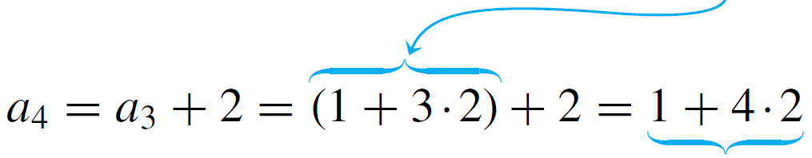

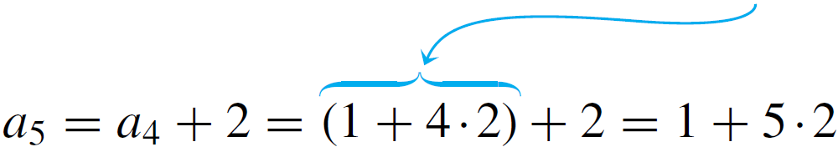


Example 1 – Solution
cont’d
Guess:
The answer obtained for this problem is just a guess. To be sure of the correctness of this guess, you will need to check it by mathematical induction.

Slide 13
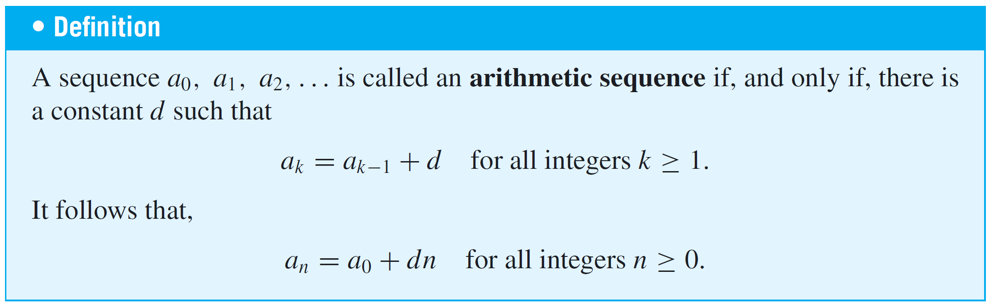
The Method of Iteration
A sequence like the one in Example 1, in which each term equals the previous term plus a fixed constant, is called an arithmetic sequence.

Slide 14
Example 2 – An Arithmetic Sequence
Under the force of gravity, an object falling in a vacuum falls about 9.8 meters per second (m/sec) faster each second than it fell the second before.
Thus, neglecting air resistance, a skydiver’s speed upon leaving an airplane is approximately 9.8m/sec one second after departure, 9.8 + 9.8 = 19.6m/sec two seconds after departure, and so forth.
If air resistance is neglected, how fast would the skydiver be falling 60 seconds after leaving the airplane?

Slide 15
Example 2 – Solution
Let s_{n} be the skydiver’s speed in m/sec n seconds after exiting the airplane if there were no air resistance.
Thus s₀ is the initial speed, and since the diver would travel 9.8m/sec faster each second than the second before,
It follows that s₀, s₁, s₂, . . . is an arithmetic sequence with a fixed constant of 9.8, and thus

Slide 16
Example 2 – Solution
cont’d
Hence sixty seconds after exiting and neglecting air resistance, the skydiver would travel at a speed of
Note that 588 m/sec is over half a kilometer per second or over a third of a mile per second, which is very fast for a human being to travel.
Happily for the skydiver, taking air resistance into account cuts the speed considerably.

Slide 17

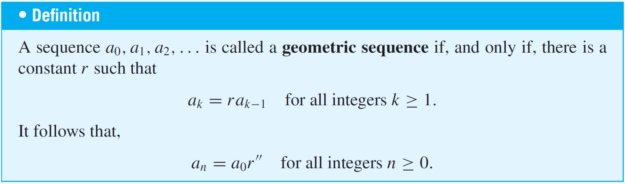
The Method of Iteration
Let r be a fixed nonzero constant, and suppose a sequence a₀, a₁, a₂, . . . is defined recursively as follows:
Use iteration to guess an explicit formula for this sequence.

Slide 18
The Method of Iteration
An important property of a geometric sequence with constant multiplier greater than 1 is that its terms increase very rapidly in size as the subscripts get larger and larger.
For instance, the first ten terms of a geometric sequence with a constant multiplier of 10 are
Thus, by its tenth term, the sequence already has the value 10⁹ = 1,000,000,000 = 1 billion.

Slide 19
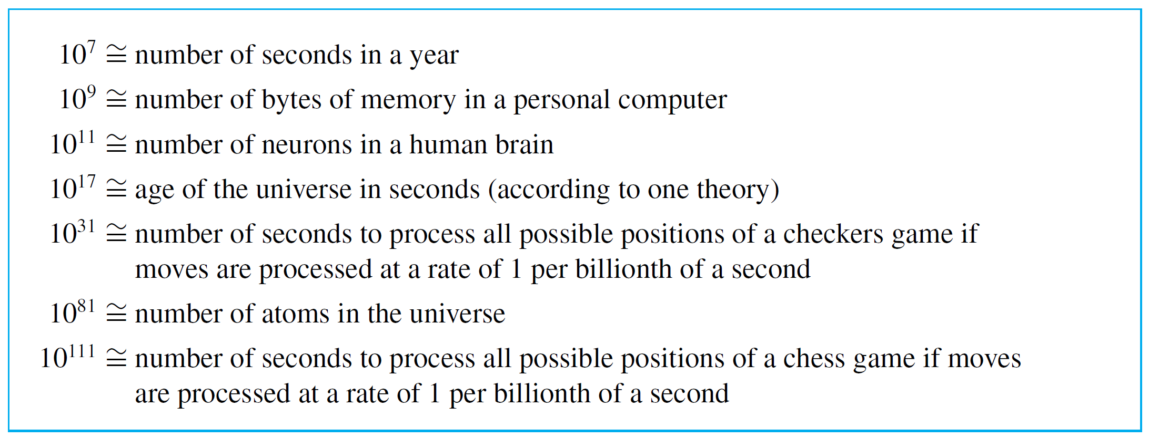
The Method of Iteration
The following box indicates some quantities that are approximately equal to certain powers of 10.

Slide 20
Using Formulas to Simplify Solutions Obtained by Iteration

Slide 21
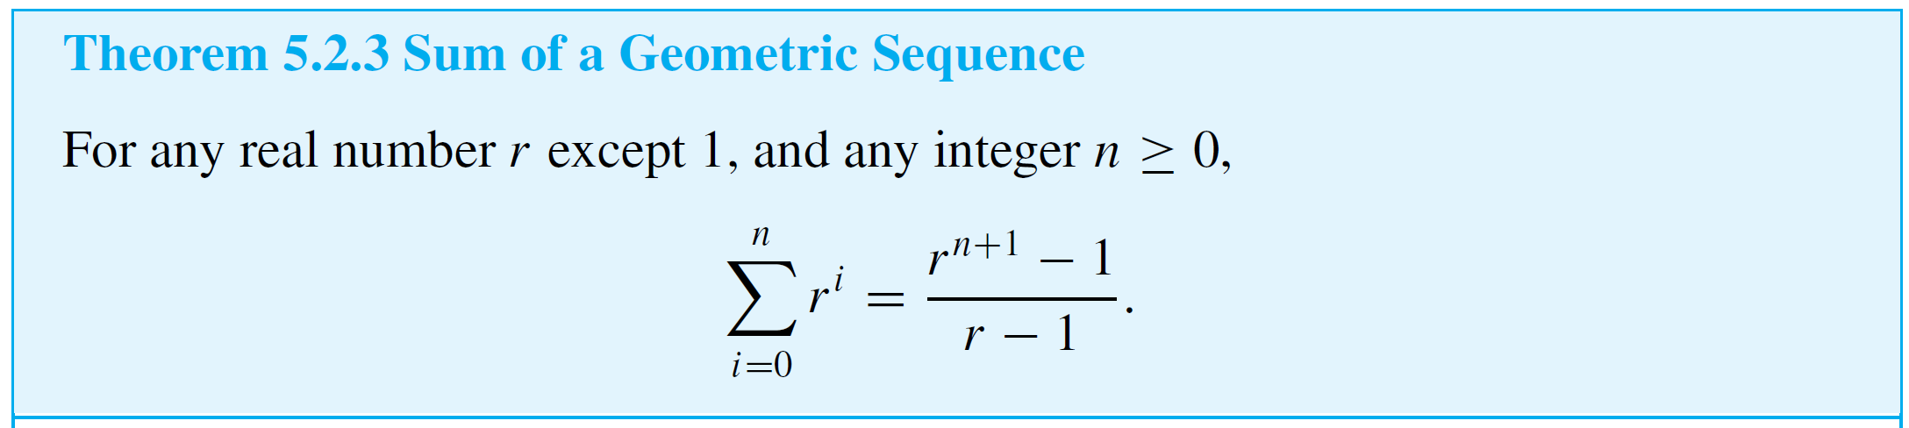
Using Formulas to Simplify Solutions Obtained by Iteration
Explicit formulas obtained by iteration can often be simplified by using formulas such as those developed earlier.
For instance, according to the formula for the sum of a geometric sequence with initial term 1 (Theorem 5.2.3), for each real number r except r = 1,

Slide 22
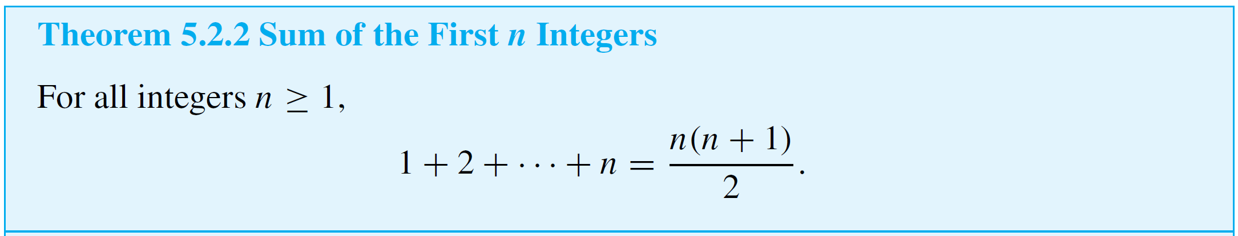
Using Formulas to Simplify Solutions Obtained by Iteration
And according to the formula for the sum of the first n integers (Theorem 5.2.2),

Slide 23

Example 5 – An Explicit Formula for the Tower of Hanoi Sequence
The Tower of Hanoi sequence m₁, m₂, m₃, . . . satisfies the recurrence relation
and has the initial condition
Use iteration to guess an explicit formula for this sequence, to simplify the answer.

Slide 24

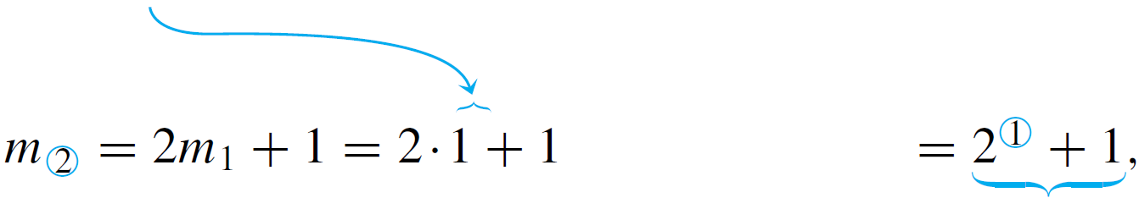
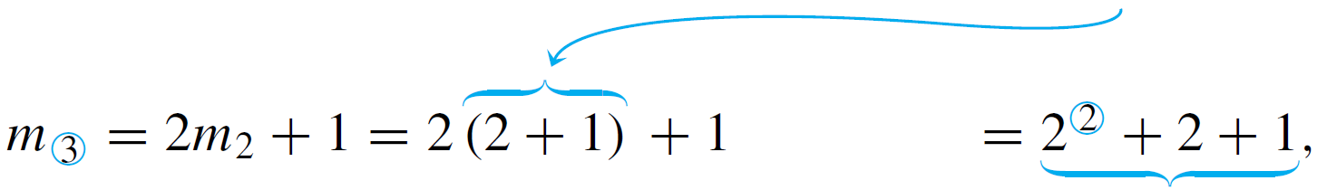
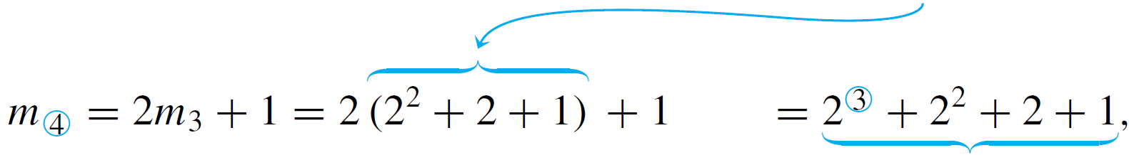
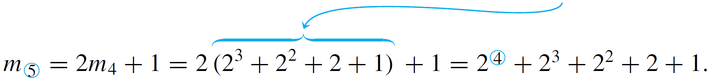
Example 5 – Solution
By iteration

Slide 25
Example 5 – Solution
cont’d
These calculations show that each term up to m₅ is a sum of successive powers of 2, starting with 2⁰ = 1 and going up to 2^{k}, where k is 1 less than the subscript of the term.
The pattern would seem to continue to higher terms because each term is obtained from the preceding one by multiplying by 2 and adding 1; multiplying by 2 raises the exponent of each component of the sum by 1, and adding 1 adds back the 1 that was lost when the previous 1 was multiplied by 2.
For instance, for n = 6,

Slide 26
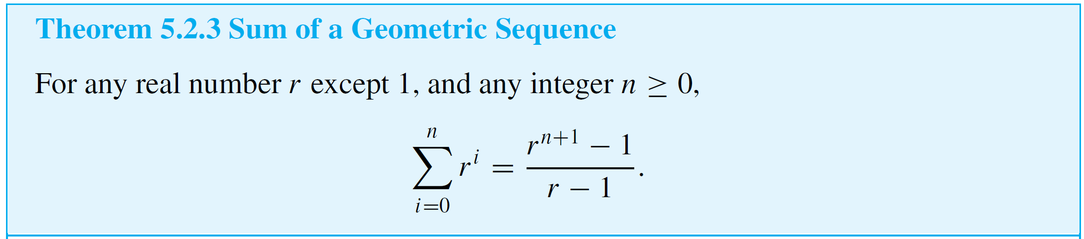
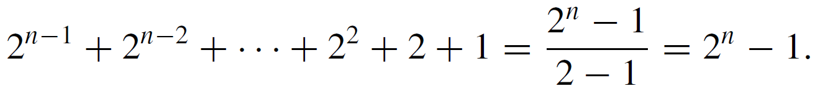
Example 5 – Solution
cont’d
Thus it seems that, in general,
By the formula for the sum of a geometric sequence (Theorem 5.2.3),

Slide 27
Example 5 – Solution
cont’d
Hence the explicit formula seems to be

Slide 28
Checking the Correctness of a Formula by Mathematical Induction

Slide 29
Checking the Correctness of a Formula by Mathematical Induction
It is all too easy to make a mistake and come up with the wrong formula.
That is why it is important to confirm your calculations by checking the correctness of your formula.
The most common way to do this is to use mathematical induction.

Slide 30
Example 7 – Using Mathematical Induction to Verify the Correctness of a Solution to a Recurrence Relation
In 1883 a French mathematician, Édouard Lucas, invented a puzzle that he called The Tower of Hanoi (La Tour D’Hanoï).
The puzzle consisted of eight disks of wood with holes in their centers, which were piled in order of decreasing size on one pole in a row of three.
Those who played the game were supposed to move all the disks one by one from one pole to another, never placing a larger disk on top of a smaller one.

Slide 31
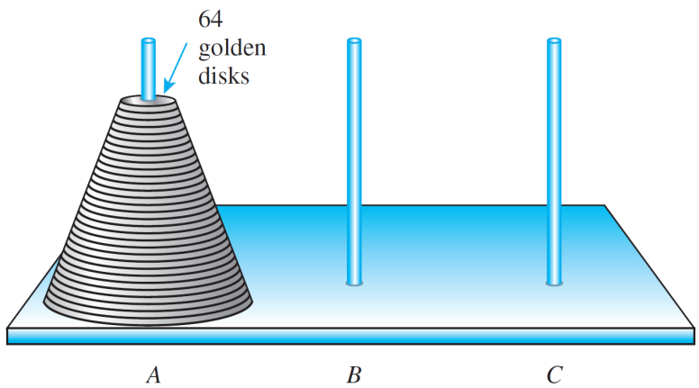
Example 7 – Using Mathematical Induction to Verify the Correctness of a Solution to a Recurrence Relation
cont’d
The puzzle offered a prize of ten thousand francs (about $34,000 US today) to anyone who could move a tower of 64 disks by hand while following the rules of the game.
(See Figure 5.6.2) Assuming that you transferred the disks as efficiently as possible, how many moves would be required to win the prize?
Figure 5.6.2

Slide 32
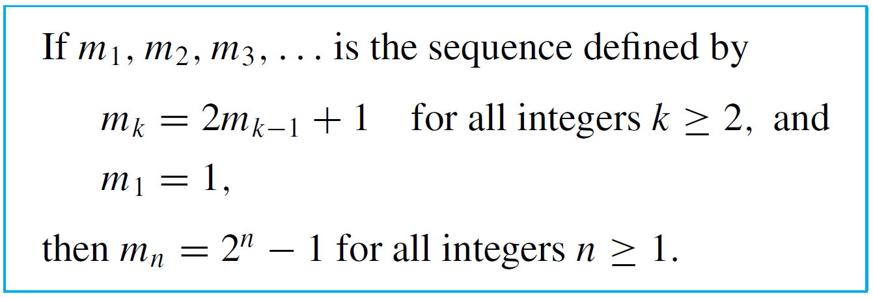
Example 7 – Using Mathematical Induction to Verify the Correctness of a Solution to a Recurrence Relation
cont’d
The solution to this is as follows:
Let m be the minimum number of moves needed to transfer a tower of k disks from one pole to another. Then,
Use mathematical induction to show that this formula is correct.

Slide 33
Example 7 – Solution
What does it mean to show the correctness of a formula for a recursively defined sequence? Given a sequence of numbers that satisfies a certain recurrence relation and initial condition, your job is to show that each term of the sequence satisfies the proposed explicit formula.
In this case, you need to prove the following statement:

Slide 34


Example 7 – Solution
cont’d
Proof of Correctness:
Let m₁, m₂, m₃, . . . be the sequence defined by specifying that m₁ = 1 and m_{k} = 2m_{k+1} + 1 for all integers k ≥ 2, and let the property P(n) be the equation
We will use mathematical induction to prove that for all integers n ≥ 1, P(n) is true.
Show that P(1) is true:
To establish P(1), we must show that

Slide 35


Example 7 – Solution
cont’d
But the left-hand side of P(1) is
and the right-hand side of P(1) is
Thus the two sides of P(1) equal the same quantity, and hence P(1) is true.

Slide 36

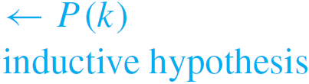


Example 7 – Solution
cont’d
Show that for all integers k ≥ 1, if P(k) is true then P(k + 1) is also true:
[Suppose that P(k) is true for a particular but arbitrarily chosen integer k ≥ 1. That is:]
Suppose that k is any integer with k ≥ 1 such that
[We must show that P(k + 1) is true. That is:]
We must show that

Slide 37






Example 7 – Solution
cont’d
But the left-hand side of P(k + 1) is
which equals the right-hand side of P(k + 1). [Since the basis and inductive steps have been proved, it follows by mathematical induction that the given formula holds for all integers n ≥ 1.]

Slide 38
Discovering That an Explicit Formula Is Incorrect

Slide 39
Discovering That an Explicit Formula Is Incorrect
The next example shows how the process of trying to verify a formula by mathematical induction may reveal a mistake.

Slide 40

Example 8 – Using Verification by Mathematical Induction to Find a Mistake
Let c₀, c₁, c₂, . . . be the sequence defined as follows:
Suppose your calculations suggest that c₀, c₁, c₂, . . . satisfies the following explicit formula:
Is this formula correct?

Slide 41

Example 8 – Solution
Start to prove the statement by mathematical induction and see what develops.
The proposed formula passes the basis step of the inductive proof with no trouble, for on the one hand, c₀ = 1 by definition and on the other hand, 2⁰ + 0 = 1 + 0 = 1 also.
In the inductive step, you suppose
and then you must show that

Slide 42




Example 8 – Solution
cont’d
To do this, you start with c_{k+1}, substitute from the recurrence relation, and then use the inductive hypothesis as follows:
To finish the verification, therefore, you need to show that

Slide 43


Example 8 – Solution
cont’d
Now this equation is equivalent to
which is equivalent to
But this is false since k may be any nonnegative integer.
Observe that when k = 0, then k + 1 = 1, and

Slide 44
Example 8 – Solution
cont’d
Thus the formula gives the correct value for c₁. However, when k = 1, then k + 1 = 2, and
So the formula does not give the correct value for c₂. Hence the sequence c₀, c₁, c₂, . . . does not satisfy the proposed formula.

Slide 45
Discovering That an Explicit Formula Is Incorrect
Once you have found a proposed formula to be false, you should look back at your calculations to see where you made a mistake, correct it, and try again.

